Slide 1
Cornerstone City Church Peninsula Plus Community Hoo Are Ya
23rd February 2025

Slide 2


Slide 3
An Army Of Ordinary People
CCLI Song # 222241
Dave Bilbrough
© 1983 Thankyou Music (Admin. by Integrity Music Ltd)
For use solely with the SongSelect® Terms of Use. All rights reserved. www.ccli.com
CCLI Licence No. 33265

Slide 4
1/4
An army of ordinary people
A kingdom where love is the key
A city a light to the nations
Heirs to the promise are we
A people whose life is in Jesus
A nation together we stand
Only through grace are we worthy
Inheritors of the land

Slide 5
2/4
A new day is dawning
A new age to come
When the children of promise
Shall flow together as one
A truth long neglected
But the time has now come
When the children of promise
Shall flow together as one

Slide 6
3/4
A people without recognition
But with Him a destiny sealed
Called to a heavenly vision
His purpose shall be fulfilled
Come let us stand strong together
Abandon ourselves to the King
His love shall be ours forever
This vict'ry song we shall sing

Slide 7
4/4
A new day is dawning
A new age to come
When the children of promise
Shall flow together as one
A truth long neglected
But the time has now come
When the children of promise
Shall flow together as one

Slide 9
This I Believe (The Creed)
CCLI Song # 7018338
Ben Fielding | Matt Crocker
© 2014 Hillsong Music Publishing Australia (Admin. by Hillsong Music Publishing UK)
For use solely with the SongSelect® Terms of Use. All rights reserved. www.ccli.com
CCLI Licence No. 33265

Slide 10
1/8
Our Father everlasting The all creating One God Almighty
Through Your Holy Spirit Conceiving Christ the Son Jesus our Saviour

Slide 11
2/8
I believe in God our Father I believe in Christ the Son I believe in the Holy Spirit Our God is three in one I believe in the resurrection That we will rise again For I believe in the name of Jesus

Slide 12
3/8
Our Judge and our Defender Suffered and crucified Forgiveness is in You
Descended into darkness You rose in glorious life Forever seated high

Slide 13
4/8
I believe in God our Father I believe in Christ the Son I believe in the Holy Spirit Our God is three in one I believe in the resurrection That we will rise again For I believe in the name of Jesus

Slide 14
5/8
I believe in You I believe You rose again I believe that Jesus Christ is Lord

Slide 15
6/8
I believe in God our Father I believe in Christ the Son I believe in the Holy Spirit Our God is three in one I believe in the resurrection That we will rise again For I believe in the name of Jesus

Slide 16
7/8
I believe in life eternal I believe in the virgin birth I believe in the saints' communion And in Your holy Church I believe in the resurrection When Jesus comes again For I believe, in the name of Jesus

Slide 17
8/8
I believe in God our Father I believe in Christ the Son I believe in the Holy Spirit Our God is three in one I believe in the resurrection That we will rise again For I believe in the name of Jesus

Slide 19
King of Kings
CCLI Song # 7127647
Brooke Ligertwood | Jason Ingram | Scott Ligertwood
© 2019 Fellow Ships Music (Admin. by Essential Music Publishing LLC)
So Essential Tunes (Admin. by Essential Music Publishing LLC)
Hillsong Music Publishing Australia (Admin. by Hillsong Music Publishing UK)
For use solely with the SongSelect® Terms of Use. All rights reserved. www.ccli.com
CCLI Licence No. 33265

Slide 20
1/11
In the darkness we were waiting
Without hope without light
Till from Heaven You came running
There was mercy in Your eyes

Slide 21
2/11
To fulfil the law and prophets
To a virgin came the Word
From a throne of endless glory
To a cradle in the dirt

Slide 22
3/11
Praise the Father
Praise the Son
Praise the Spirit three in one
God of Glory
Majesty
Praise forever to the King of kings

Slide 23
4/11
To reveal the kingdom coming
And to reconcile the lost
To redeem the whole creation
You did not despise the cross

Slide 24
5/11
For even in Your suffering
You saw to the other side
Knowing this was our salvation
Jesus for our sake You died

Slide 25
6/11
Praise the Father
Praise the Son
Praise the Spirit three in one
God of Glory
Majesty
Praise forever to the King of kings

Slide 26
7/11
And the morning that You rose
All of heaven held its breath
Till that stone was moved for good
For the Lamb had conquered death

Slide 27
8/11
And the dead rose from their tombs
And the angels stood in awe
For the souls of all who'd come
To the Father are restored

Slide 28
9/11
And the Church of Christ was born
Then the Spirit lit the flame
Now this Gospel truth of old
Shall not kneel shall not faint

Slide 29
10/11
By His blood and in His Name
In His freedom I am free
For the love of Jesus Christ
Who has resurrected me

Slide 30
11/11
Praise the Father
Praise the Son
Praise the Spirit three in one
God of Glory
Majesty
Praise forever to the King of kings

Slide 32
We Are One Body
CCLI Song # 1187763
Ed Kerr | Paul Baloche
© 1993 Integrity's Hosanna! Music
For use solely with the SongSelect® Terms of Use. All rights reserved. www.ccli.com
CCLI Licence No. 33265

Slide 33
1/2
Though we are many we are one body
We are one body in Christ
Though we are many
We are one body
We are one body in Christ

Slide 34
2/2
One faith in the Lord Jesus Christ
Binding us together in one cause
One hope in the one God
One Father over all

Slide 35


Slide 36
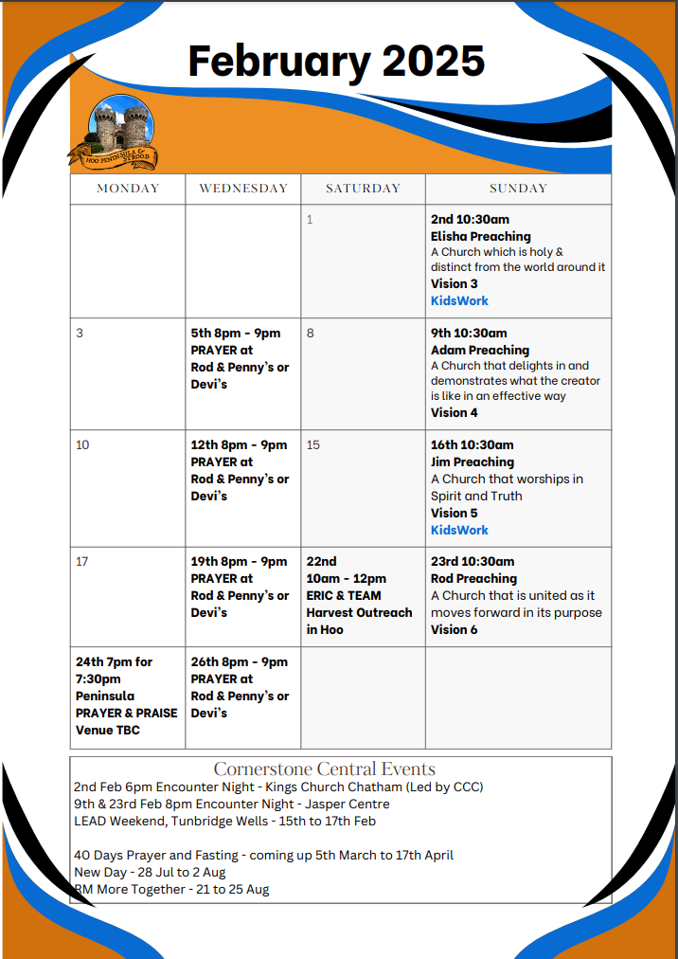

Slide 37

Grow Group 1
Grow Group 1 Name: On YOUR MARK!

Slide 38
Leaders
Leaderss
Phil & Kim
Maria (Mia) Warren
Matthew Harrison
Richard & Elisha Acheampong
Phil & Kim
Maria (Mia) Warren
Matthew Harrison
Richard & Elisa Acheampong

Slide 39
Q1 into Q2 Meeting Dates
Q1 into Q2 Meeting Dates
Month | Date / Day | Host
January | Saturday 11th | Maria
 | Wednesday 22nd | Maria
February | Saturday 8th | Venue Needed
 | Wednesday 19th | Phil & Kim
March | Saturday 8th | Richard & Elisha
 | Wednesday 19th | Venue Needed
April | Saturday 12th | Matt
 | Wednesday 30th | Venue Needed

Slide 40

Storm Walker
Storm Walker
Symbolising, trust in Jesus Christ through life's storms.
Mark 4:35-41

Slide 41


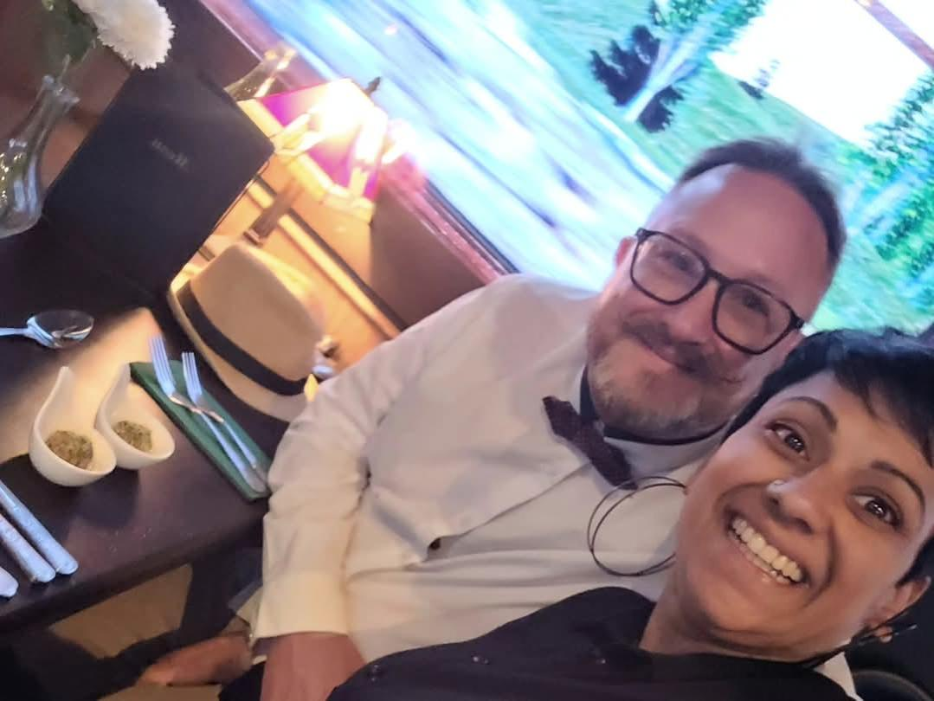
Group Leaders
Micheal and Mwamba
Wilfred and Parveen
Hannah

Slide 42
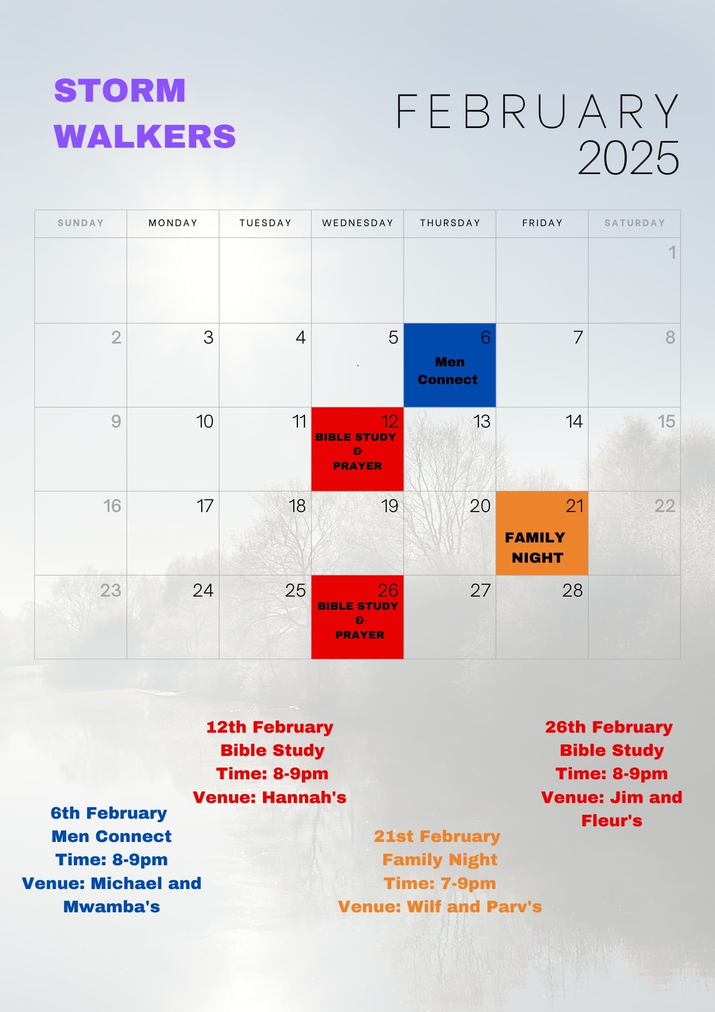

Slide 43
The Bereavement Journey
The Bereavement Journey is for anyone who has been bereaved at any time and in any way Starts Monday 3rd March
7 Sessions ending at Easter
Daytime group 10.30am to 12.30pm Jasper Centre
They may look to run another one in the evening later in the year
Please note that (as the video highlights) this is for anyone that has lost someone in their life
who would benefit and value time to reflect and work through their grief and loss.
It doesn’t have to be very recently. Angela and Lena

Slide 44
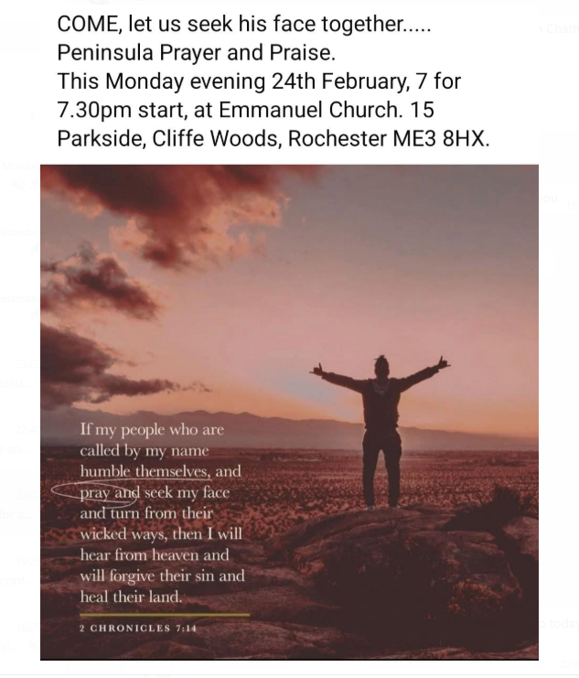

Slide 45
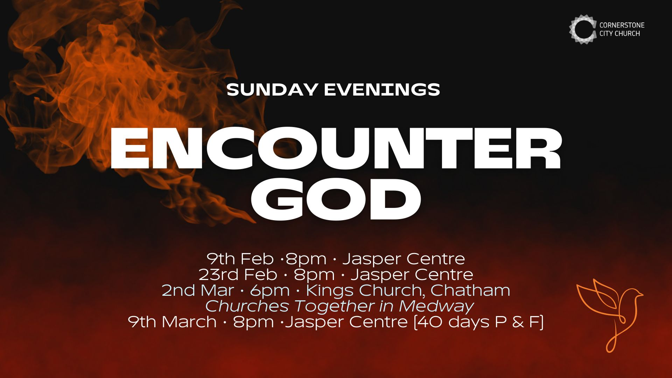

Slide 46


Slide 47
Jesus At The Centre
CCLI Song # 6115180
Adam Ranney | Israel Houghton | Micah Massey
© 2011 Integrity Worship Music; Integrity's Praise! Music; Sound Of The New Breed; Heart Anthem Music
For use solely with the SongSelect® Terms of Use. All rights reserved. www.ccli.com
CCLI Licence No. 33265

Slide 48
1/7
Jesus at the center of it all
Jesus at the center of it all
From beginning to the end
It will always be it's always been You Jesus Jesus

Slide 49
2/7
And nothing else matters
Nothing in this world will do
Jesus You're the center
Ev'rything revolves around You Jesus You
At the center of it all

Slide 50
3/7
Jesus be the center of my life
Jesus be the center of my life
From beginning to the end
It will always be it's always been You Jesus Jesus

Slide 51
4/7
And nothing else matters
Nothing in this world will do
Jesus You're the center
Ev'rything revolves around You Jesus You

Slide 52
5/7
From my heart to the heavens Jesus be the center
It's all about You yes it's all about You
From my heart to the heavens Jesus be the center
It's all about You yes it's all about You (Jesus)
(REPEAT)

Slide 53
6/7
Jesus be the center of Your church
Jesus be the center of Your church
And ev'ry knee will bow
And ev'ry tongue shall confess You Jesus Jesus Jesus Jesus
Jesus Jesus Jesus Jesus

Slide 54
7/7
And nothing else matters
Nothing in this world will do
Jesus You're the center
Ev'rything revolves around You Jesus You
At the center of it all

Slide 55
2 Corinthians 14 May the grace of the Lord Jesus Christ, and the love of God, and the fellowship of the Holy Spirit be with you all
Surely goodness and mercy shall follow me all the days of my life, and I shall dwell in the house of the Lord forever.

